Slide 1


Project Midpoint Checkpoint
Nickhil Tekwani
CS7290

Slide 2


Table of Contents
Previous Topic
Issues with Previous Topic
New Topic Background
Dataset and Goals
EDA
Analysis
Preliminary Conclusion
Next Steps

Slide 3
Previous Topic Overview
How is artificial intelligence (AI) being used to optimize clinical trial design, and what impact is it having on the time and success rate of drug/device development in biotech and pharmaceutical companies?
Goal: Improve clinical trial design using historical data and Subject-Matter-Expert (SME) input to improve process efficiency and improve data integrity
Optimize process for hundreds of companies through better Patient Selection and more robust Data Integrity
Provide more accurate insights to policymakers and regulators
Data Sources: ClinicalTrials.Gov, Kaggle, FDA.gov

Slide 4
Issues With Previous Topic
Research question was intriguing, but overstudied
Hard to find niche that would allow for satisfactory project
Data Sources
ClinicalTrials.Gov: Data was not expansive enough to reproduce clinical trials
Kaggle: Data no longer available, not sure on robustness
FDA.gov: No relevant data

Slide 5
New Topic
Rumor: WHO delays announcements regarding contagious diseases when it is politically inconvenient
Research Question: Is the World Health Organization (WHO) slower to make announcements for politically sensitive countries as compared to non-sensitive countries?
Ideated from “Plan B” discussion with Professor Church
Notes:
Who posts outbreaks of contagious diseases around the world over the last 30 years.
The WHO is an official organization with a mandate to do this.
Promed is a crowd-sourced alternative that issues more announcements.
There have been some rumors that WHO may be slow to make announcements if they are politically inconvenient. It is possible that crowd-sourced alternatives could scoop official sources. We would like to compare and contrast these two sources to address such rumors.

Slide 6
Dataset
Northeastern Discovery Cluster: “deltas” dataset
Columns 5 & 6: the links from Who and ProMed
Col 1: Difference in days between the 2 sources
Col 3: Cosines, which indicate how close the 2 URL’s are (as determined by BERT NLP Model)
Goal: Use dataset to determine if there is a delta between Promed’s crowdsourced reporting of a certain disease incident and WHO’s official reporting of a disease based on political sensitivity

Slide 7
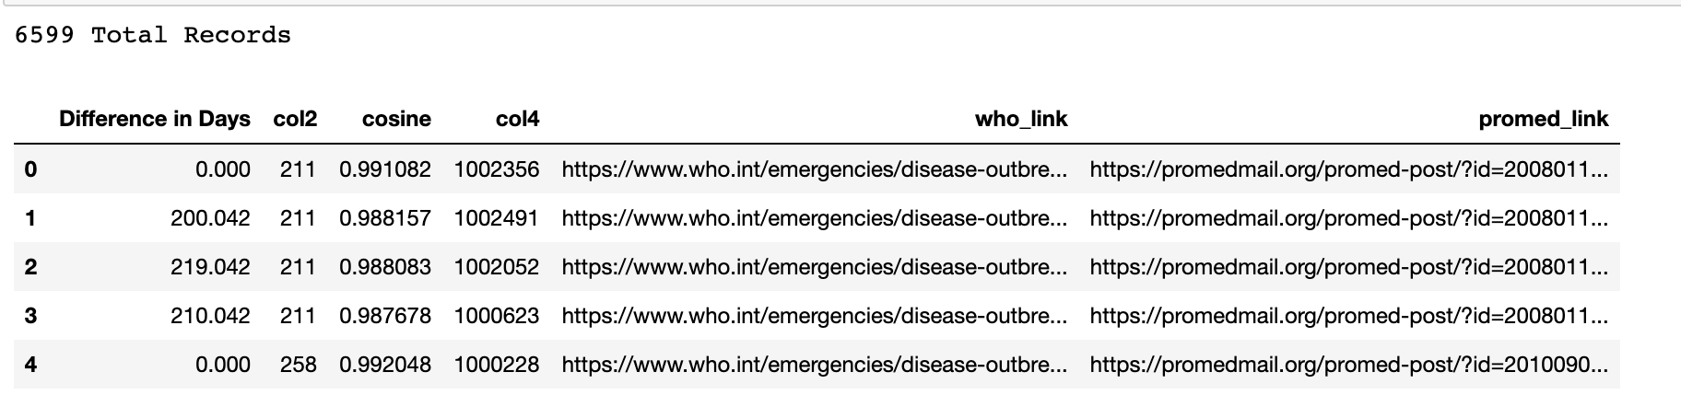
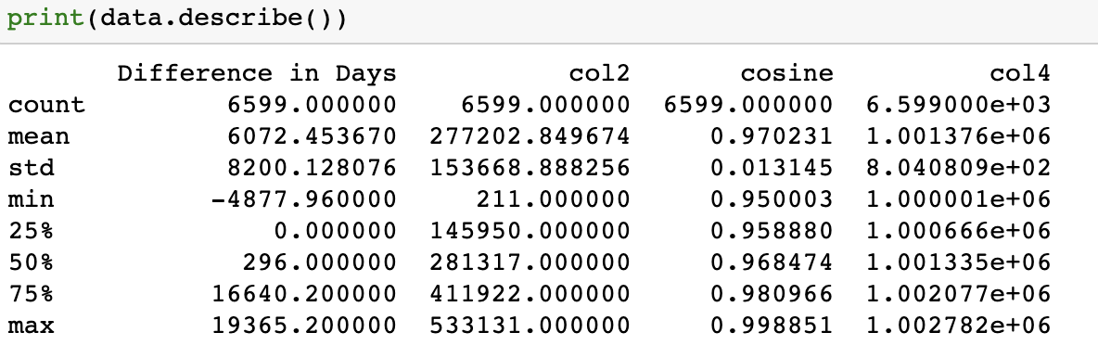
Exploratory Data Analysis (EDA)
Notes:
The mean difference in days is approximately 6072, which indicates that there are significant differences between the announcement dates of WHO and ProMED in the dataset.
However, this number is affected by extreme values, as the standard deviation is quite large (8200).
The median difference in days is 296, which implies that at least 50% of the dataset has a difference in days of 296 or less. This suggests that a considerable proportion of the announcements are made within a relatively short time frame.

Slide 8
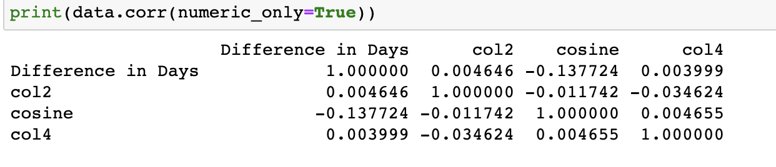
EDA: Pearson Correlation
Notes:
The correlation coefficients show that there is a weak negative correlation between the "Difference in Days" and "cosine" columns (-0.137724).
This indicates that there is a slight tendency for announcements with higher cosine similarity (more similar) to have smaller differences in days between them.
However, this relationship is quite weak and should not be considered a strong predictor yet

Slide 9
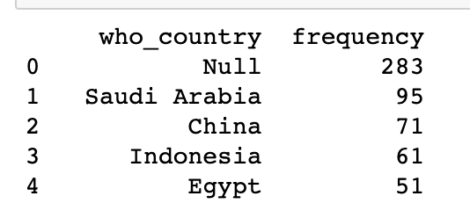
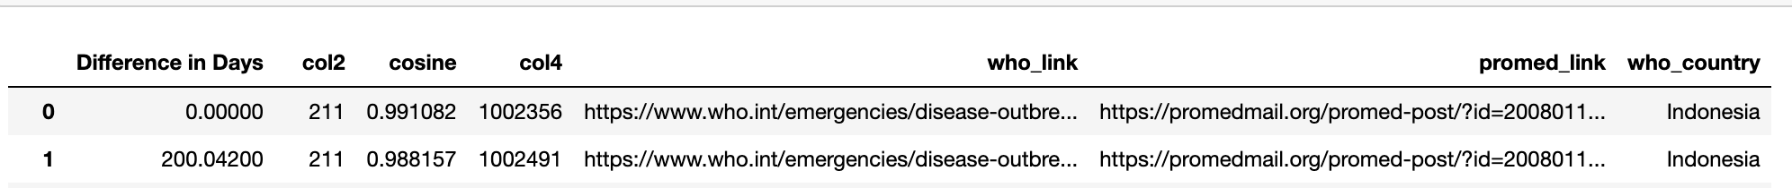
Event Analysis by Country || Part 1
Scraped WHO Links from first 1000 records to get relevant country
Couldn’t find 28.3% of countries
86 Unique countries
18 Countries w/ 10+ appearances

Slide 10
Event Analysis by Country || Part 2
Categorized countries as “politically sensitive”
['China', 'Russia', 'Iran', 'North Korea', 'Saudi Arabia', 'Syria', 'Venezuela', 'Myanmar', 'Cuba', 'Sudan', 'Iraq', 'Afghanistan', 'Yemen', 'Libya', 'Zimbabwe']
Rest of the 86 were in “non sensitive” bucket
Notes:
The politically sensitive countries are those with known political tensions, conflicts, or other issues that may affect the WHO's ability to make timely announcements.

Slide 11
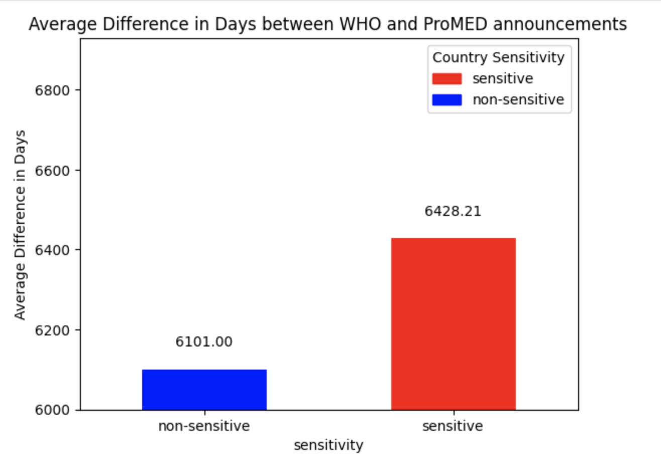
Event Analysis by Country || Part 3
Calculate the average difference in days for politically sensitive and non-sensitive countries
327 Day Difference
Notes:
we observe that the average difference in days between WHO and ProMED announcements is 6101 days for non-sensitive countries and 6428 days for sensitive countries.
The difference between these two averages is around 327 days, indicating that there might be a delay in WHO announcements for politically sensitive countries compared to non-sensitive ones.

Slide 12
Preliminary Conclusion
# of Days between WHO/Promed for Politically Sensitive Countries: 6428
# of Days between WHO/Promed for Non Sensitive Countries: 6101
327 Day Difference indicates that WHO may delay announcements for politically sensitive countries
To Further Confirm Findings:
Analyze rest of data set (only looked at first 1000 of 6600)
Investigate content of announcements to find systematic bias by WHO
Consider other factors that may influence timing, such as:
Severity of the disease outbreak, country's infrastructure, or availability of reliable info

Slide 13
Next Steps
Solve “threading” issue
Dive deeper into how to actually define a “politically sensitive” region
Compare other features besides country (related to nature of disease)
Run same analysis on all 6600 records
Visualize results/EDA in a meaningful way (less numbers, more results)
Notes:
Threading: There are lots of updates over time, as the same issue is reported again and again.
This makes it hard to address rumors like the one again because it is very likely that the same issue is being reported many times by both sources.
The Deep Learning model may happen to find a match between one pair of these announcements, but that doesn’t really address the rumor if they are not related to the exact same announcement.

Slide 14
Conclusion Slide
Rumor: WHO delays announcements regarding contagious diseases when it is politically inconvenient
Research Question: Is the World Health Organization (WHO) slower to make announcements for politically sensitive countries as compared to non-sensitive countries?
Conclusion: There are potential indications that the rumor is true
Next Steps: Consider more factors to make conclusion more robust

